Slide 1
DBMS Languages
In DBMS implementation, first define conceptual and internal schema
When levels are not distinct, data definition language (DDL) is used by DBA and database designers to define conceptual and internal schemas.

Slide 2
DBMS Languages
In DBMS where separation is distinct between conceptual and internal levels,
DDL is used to specify conceptual schema
Storage definition language(SDL) is used to specify internal schema
Mappings will be specified by either of the above languages
View definition language will be used by the external level
Mostly DDL will be used for definition of conceptual schema and external schema

Slide 3
SQL
SQL
relational database language
Includes DDL – Data Definition Language
VDL - (View Definition Language)
DML(Data Manipulation Language)
DCL – Data Control Language
TCL – Transaction Control Language
Constraints specification, schema evolution

Slide 4
DML
High level or nonprocedural DML
Entered interactively from a terminal
Embedded in a general purpose programming language
Low level or procedural
Embedded in a general purpose language

Slide 5
DML
Low-level DMLs – record-at-a-time DMLs
High-level DMLs set-at-a-time or set-oriented DMLs
Query in high-level DML such as SQL-declarative
They specify what data is to be retrieved, rather than how to retrieve it

Slide 6
DML
When DML commands are embedded in a general purpose programming language, (Ex. SQL statements in Visual Basic application)
The general purpose programming language is called host language
The DML is called data sublanguage
A high-level DML used in a stand-alone manner: query language

Slide 7
DBMS Interfaces
Menu-Based Interfaces for Browsing : view database using menus in browser
Forms-Based Interfaces : fill the form with specifications
Graphical User Interface
Display a diagram of the schema
Uses menus and forms
Pointing device such as mouse to pick parts of the schema diagram

Slide 8
DBMS Interfaces
Natural Language Interface
Ex. Query to Google
Query in natural language like English
Interpreted and converted to query
Query submitted to DBMS
Result given to user for further dialogue
Interface for Parametric Users
Special interface
Small set of commands given
Similar to function keys to perform certain tasks with out executing numerous commands

Slide 9
DBMS Interfaces
Interfaces for the DBA
Commands given specifically to DBA staff
Includes commands for creating accounts, setting system parameters, reorganizing storage structures of a database etc.

Slide 10
Classification of DBMSs
Based on data model – relational and object data model; network and hierarchical data model
Relational DBMSs
Object DBMSs
Object relational DBMSs Ex. MsAccess
Network DBMSs
Hierarchical DBMSs

Slide 11
Classification of DBMSs
Based on number of users
Single user systems
Multiuser systems
Based on number of sites over which DBMS is distributed
Centralised, single site, multiple users but single database and DBMS
Distributed DBMSs over many sites connected by a computer network
Homogeneous DDBMSs with same software at multiple sites
Heterogeneous DDBMSs with different software at multiple sites
Federal DBMS or Multibase system is a DBMS which is loosely coupled and has a degree of autonomy for participating DBMSs

Slide 12
Classification of DBMS
Based on cost (old data)
Ranging from $100 to $100,00
Majority between $10,000 and $100,000
Based on access path
An access path is a structure that makes search for particular database records efficient
Based on purpose
Special purpose or general purpose DBMS
Special purpose ex airline reservation system, telephone directory of the past
Online transaction processing systems that have concurrent transactions

Slide 13
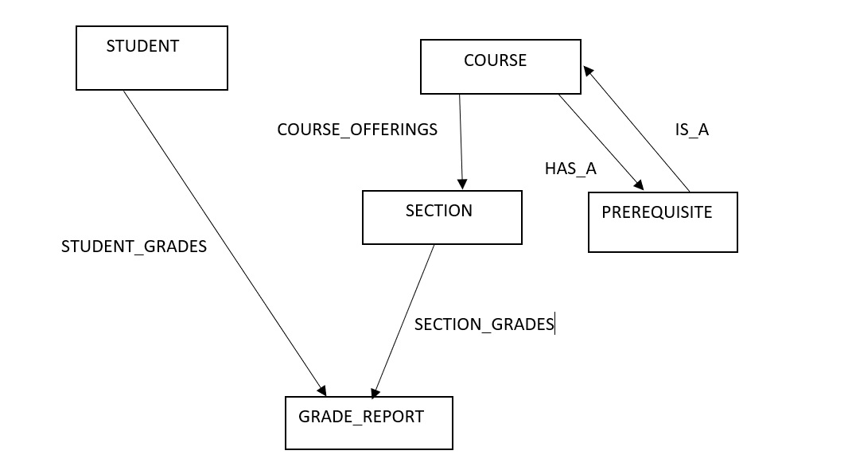
Network Model
Student database

